Slide 1
Machine Learning

Slide 2
Semi Supervised Learning

Slide 3
Semi Supervised Learning
It is a combination of supervised and unsupervised learning
It is used when we have labelled training data and a larger amount of unlabelled training data
We try to come up with some learning algorithm that can work even when the training data is limited

Slide 4
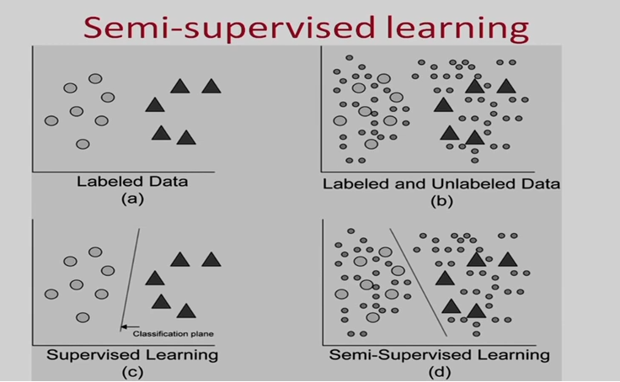

Slide 5
Sequential learning

Slide 6
Sequential learning
Learning not in a single shot but over the time
It predicts and then gets feedback and based on that it learns.

Slide 7
Sequential learning
Online learning
  Stock market prediction
  Based on few experts suggestions you buy some stock and then based on actual feedback you learn over the time. (not only you but all experts also learns based on feedback: this is called full learning)
Multi-armed Bandits
  Based on the symptoms of a patient your algorithm suggest for treatments and you go for suppose 2nd treatment and then based on feedback (the patient recovers or deteriorates) you learn but you don’t know the output of other treatments (so not full learning)
Reinforcement learning
  Robot navigation
  Robot need to reach from one part of a room to other end of the room. It can take decisions- left, right, back, forward based on the surrounding place. So mapping is required to learn from surrounding places to decisions. Based on taken decisions it will learn.

Slide 8
Reinforcement Learning
No labels, No prepared training data
These are neither supervised nor unsupervised in nature
In RL, an agents learns via its interactions with an environment (feedback-driven policy learning)
Learning by trial and error
Data are not given. The learning agent must generate them by interacting with the environment
Typically these are problems where you are learning to control the behavior of the system
The model learns and updates itself through reward/punishment
It learns by itself what is the best strategy, called a policy, to get the most reward over time.
Model is evaluated by means of the reward function after it had some time to learn.

Slide 9
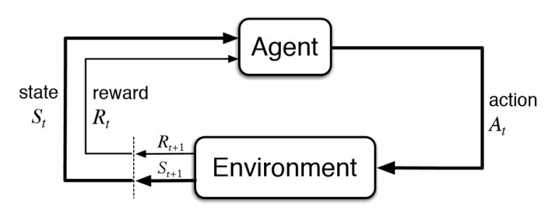
We have an agent which acts in an environment
So the agent is in a particular state and can take action and this action can impact the environment
and environment goes to a new state and give reward/penalty/neutral to agent
Agent is continually acting in this environment
And the reinforcement learner learn a policy- given a state what action to take so that not only the short term reward is optimized but the overall utility of the agent over its entire time horizon is optimized.

Slide 10
Types of Reinforcement Learning Problems
can be used for a variety of planning problems including
  travel plans,
  budget planning and
  business strategy.

Slide 11
Most Important Reinforcement Learning Algorithms
Q-learning
SARSA (State–action–reward–state–action) is an algorithm for learning a Markov decision process policy

Slide 12
Practical Applications
Self-driving cars
Intelligent robots
AlphaGo Zero (the latest version of DeepMind’s AI system playing Go)

Slide 13
Batch learning (offline learning)
The system is incapable of learning incrementally
It must be trained using all the available data
This will take a lot of time and computing resources, so it is typically done offline.
First the system is trained, then it is launched into production without learning anymore

Slide 14
Online (Incremental) Learning
System is trained incrementally by feeding it data instances sequentially, either individually or by small groups called mini batches.
Each learning step is fast and cheap, so the system can learn about new data on the fly, as it arrives
Useful for systems that receive data as continuous flow (e.g., stock prices) and need to adapt to change rapidly.
It is also a good option if there is limited computing resources.
We can discard the data on which it has learned.
Can be used to train systems on huge datasets that cannot fit in one machine’s main memory (out-of-core learning)
Whole process is usually done offline (not on the live system)

Slide 15
Online (Incremental) Learning
Important parameter- learning rate
If too high
  System will adapt to new data but will forget old data
If too slow
  It will learn more slowly

Slide 16
Machine Learning Tasks
Task Performance Measure
Classification error
Regression error
Clustering scatter of points in a single cluster/purity
Associations support/confidence
Reinforcement learning cost/reward

Slide 17
Inductive learning versus Deductive Learning
Deductive Learning
  logical,
  From facts
Inductive learning
  From evidence
  Empirical sugessions

Slide 18
Main Challenges of Machine learning
How good a model is?
How do I choose a model?
Do I have enough data?
Is the data of sufficient quality?
  Errors in data
  Missing values
How confident can I be of the results?
Am I describing the data correctly?
  Are age and income enough? Should I look at gender also?
  How should I represent age? As a number, or as young, middle age, old etc.
How to ensure generalization
  Ability of an ML algorithm to do well on future test data

Slide 19
Main Challenges of Machine learning
Examples of bad data
  Insufficient quantity of training data
  Nonrepresentative training data
  Poor quality data
  Irrelevant features
Examples of bad algorithms
  Overfitting the training data
  Underfitting the training data

Slide 20
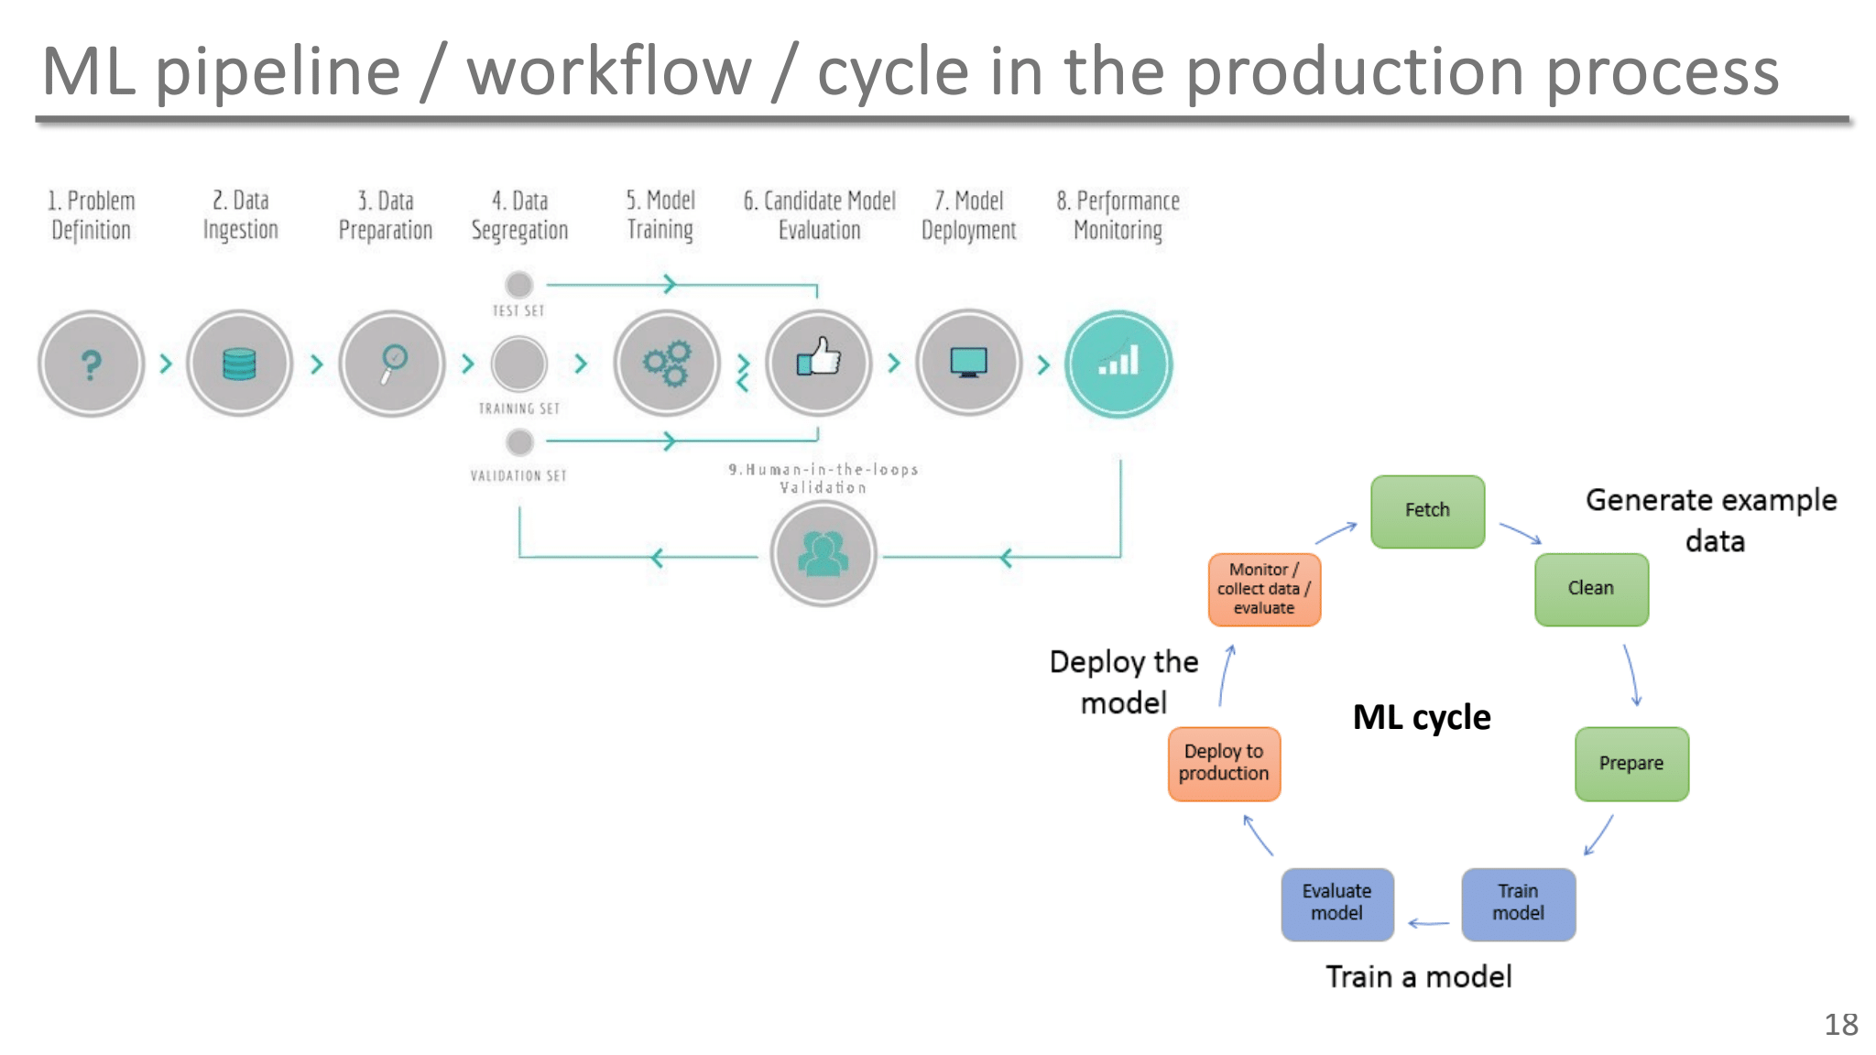
ML Pipeline/workflow/cycle in the production process

Slide 21
Assumptions in ML
•IID (Independent and Identically distribution of data) assumptions
  Independent
    Each data sample is drawn independently of the others, meaning the outcome of one sample does not affect the outcome of another
    This ensures there are no dependencies or correlations between the samples in the dataset
  Identically
    All data points come from the same underlying distribution
      if the data is drawn from a Gaussian distribution, all samples must follow the same Gaussian distribution
    This assumption ensures the learning algorithm can generalize from the training data to unseen data, as the test set is assumed to follow the same distribution
    Test and training data are generated by a probability distribution

Slide 22
performance of machine learning
Make the training error small
reduce the gap between training and test error

Slide 23
Testing and validating
We split data into two sets: training set and test set
The error rate on new cases is called the generalization error (or out-of-sample error)
By evaluating the model on test set , we get an estimation of generalization error.
If the training error is low but the generalization error is high, it means the model is overfitting the training data.

Slide 24
Underfitting the training data
Opposite of overfitting
It occurs when model is too simple to learn the underlying structure of the data.
If your model is underfitting the training data, adding more training examples will not help.
The main options to fix this problem are:
  Selecting a more powerful model, with more parameters
  Feeding better features to the learning algorithm (feature engineering)
  Reducing the constraints on the model
In supervised learning, underfitting happens when a model is too simple to represent all the relevant class characteristics i.e. unable to capture the underlying pattern of the data.
  These models usually have high bias and low variance.
  High training error and high test error.
It happens when we have very less amount of data to build an accurate model or when we try to build a linear model with a nonlinear data.
Also, these kind of models are very simple to capture the complex patterns in data like Linear and logistic regression.

Slide 25
Overfitting the training data
The gap between training and test error is too large
Model performs well on training data, but it does not generalize well.
Happens when model is too complex relative to the amount and noisiness of the training data.
Possible solutions are:
  To simplify the model by selecting one with fewer parameters (e.g.. A linear model rather than a high-degree polynomial model), by reducing the number of attributes in the training data or by constraining the model
  To gather more training data
  To reduce the noise in the training data(e.g., fix data errors and remove outliers)
Constraining a model to make it simpler and reduce the risk of overfitting is called regularization.
In supervised learning, overfitting happens when our model is too complex and fits irrelevant characteristics (noise) along with the underlying pattern in data.
It happens when we train our model a lot over noisy dataset.
These models have low bias and high variance.
Low training error and high test error
These models are very complex like Decision trees which are prone to overfitting.

Slide 26
Understanding the Bias-Variance Tradeoff
prediction errors
  bias and variance
There is a tradeoff between a model’s ability to minimize bias and variance
Understanding of these errors avoids the mistake of overfitting and underfitting
If models are more flexible (less bias), it becomes more data sensitive (high variance)
If models are less data sensitive (less variance), it becomes less flexible (high bias)

Slide 27
Bias
Also called “error due to squared bias”
difference between the average prediction of our model and the correct value which we are trying to predict
Model with high bias pays very little attention to the training data and oversimplifies the model
It always leads to high error on training and test data
A high level of bias can lead to underfitting
  which occurs when the algorithm is unable to capture relevant relations between features and target outputs
A linear algorithm often has high bias, which makes them learn fast.
In contrast, nonlinear algorithms often have low bias.

Slide 28
variance
Variance indicates how much the estimate of the target function will alter if different training data were used.
Variance is the variability of model prediction for a given data point or a value which tells us spread of our data.
Model with high variance pays a lot of attention to training data and does not generalize on the data which it hasn’t seen before.
As a result, such models perform very well on training data but has high error rates on test data.
Variance can lead to overfitting, in which small fluctuations in the training set are magnified.

Slide 29
Bias-Variance Summary
variance refers to the amount by which that would change if we estimated it using a different training data set
  more flexible models have higher variance
bias refers to the error that is introduced by approximating a extremely complex problem by a much simpler model
  more flexible models have low bias

